Slide 1
Bioinformatics about restriction enzyme

Slide 2
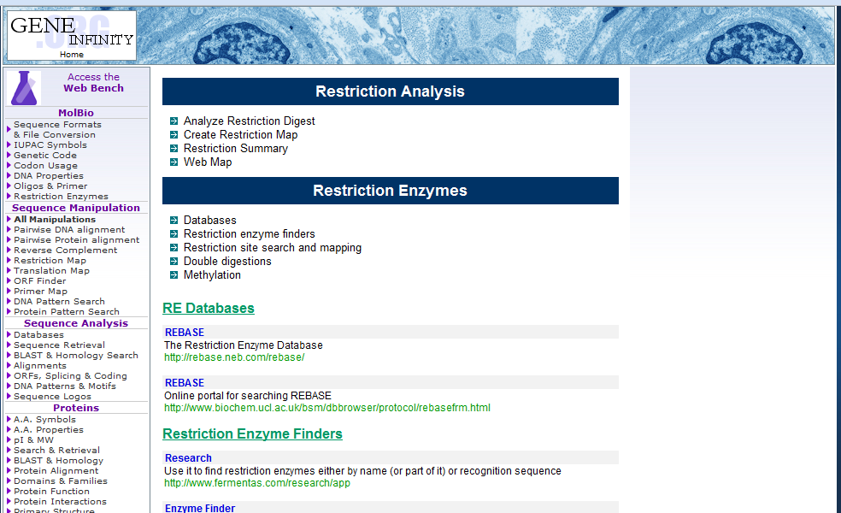
http://www.geneinfinity.org/sp_resenzym.html
Gene Infinity

Slide 3
Contd….

Slide 4
Contd….

Slide 5
Contd….

Slide 6
Restriction Digest

Slide 7
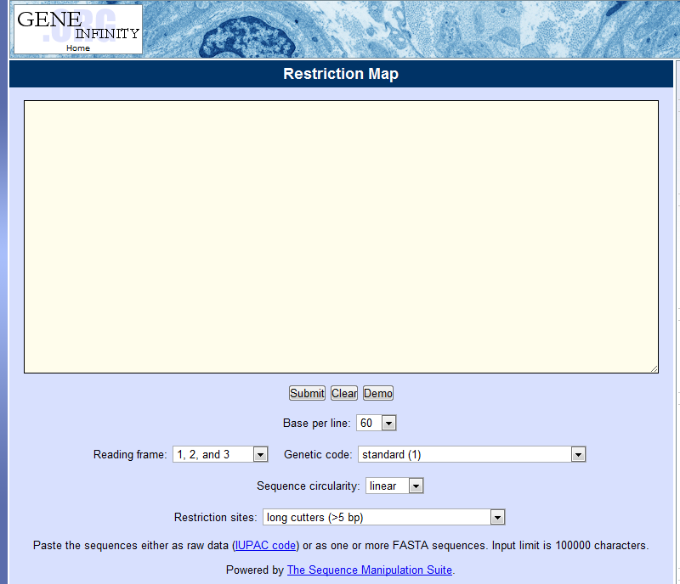
Create Restriction Map

Slide 8
Web Map References

Slide 9
Web Map References

Slide 10
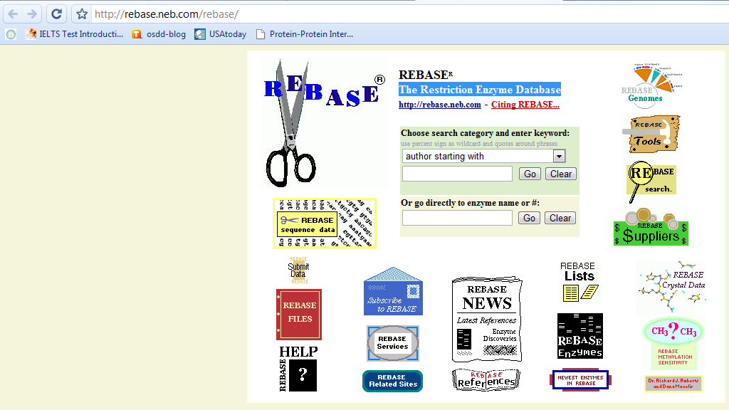
The Restriction Enzyme Database

Slide 11
The Restriction Enzyme Database

Slide 12
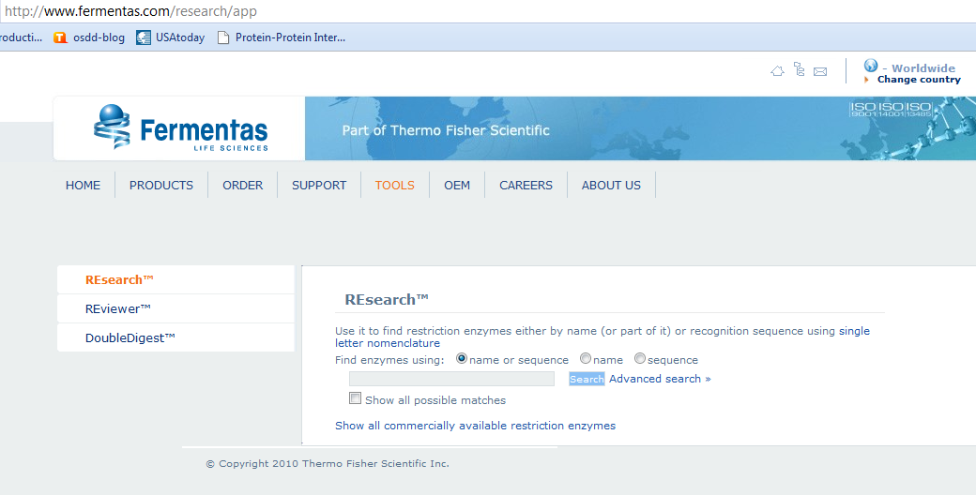
RE finder

Slide 13
Enzyme finder

Slide 14
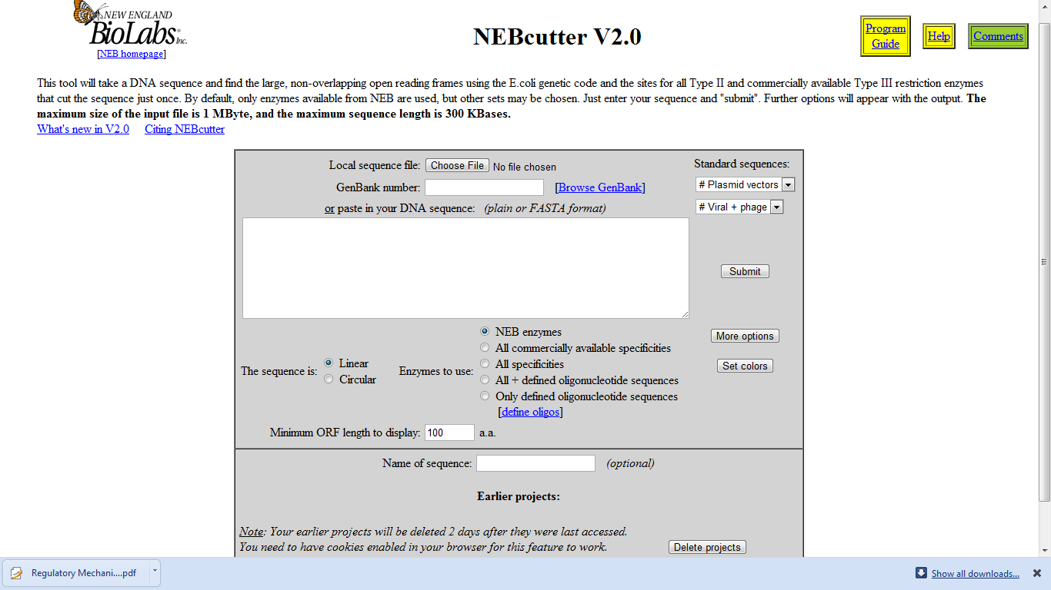
Restriction enzyme search and mapping
NEBcutter V2.0

Slide 15
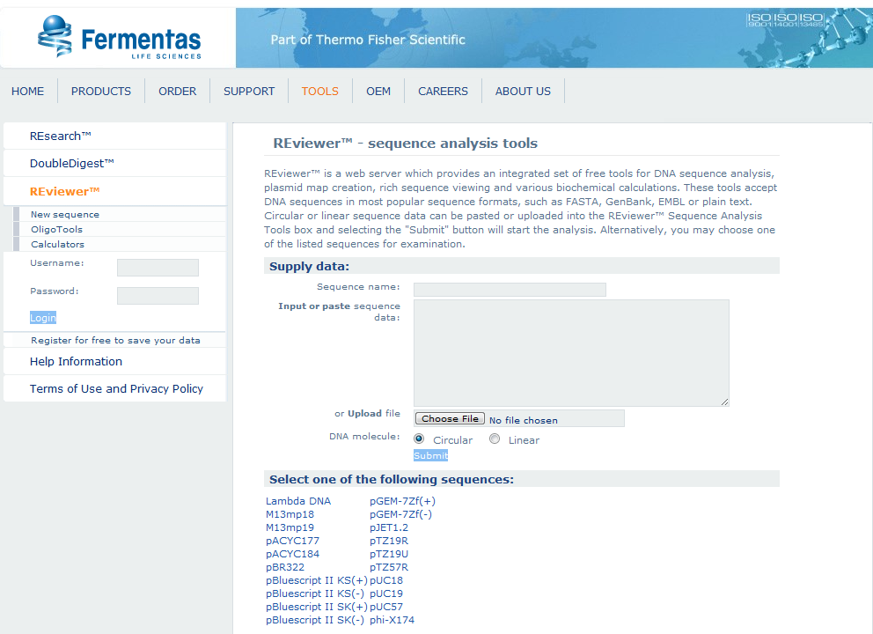
REviewer™ - sequence analysis tools

Slide 16
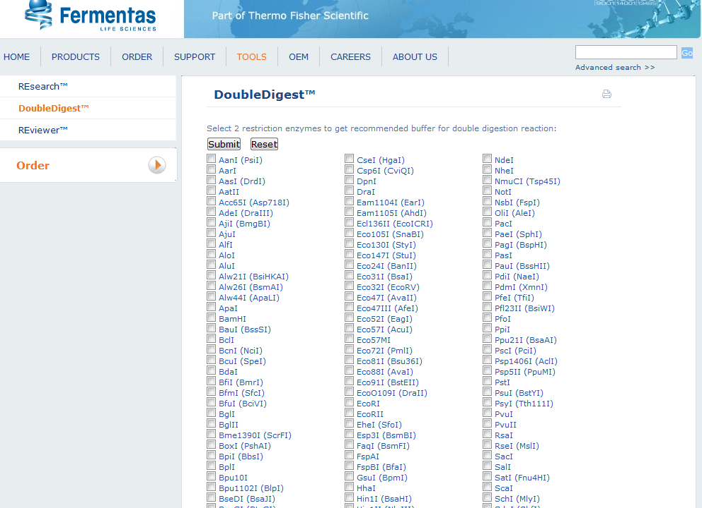
Double Digestions (http://www.fermentas.com/en/tools/doubledigest)

Slide 17
Double Digestions contd……

